Slide 1
More Python
Language Syntax and Programming Constructs
Gene Olafsen

Slide 2
Object-Oriented Concepts
Abstraction
Encapsulation
Inheritance
Polymorphism

Slide 3
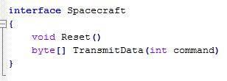
Interfaces
Interfaces separate contract (or intent) from implementation.
There are no interfaces in Python.

Slide 4
Duck TYping
"If it talks and walks like a duck, then it is a duck"
If you don't like the term "Duck Typing" use "Dynamic Binding".
Consider how an object behaves, rather than its type or class.

Slide 5
Duck Typing protection
Class Introspection
hasattr
Exception Handling
Try
Catch
Finally

Slide 6
abstract Base Class
Abstract classes are classes that contain one or more abstract methods.
An abstract method is a method that is declared, but contains no implementation.
Abstract classes may not be instantiated directly...
Abstract classes require subclasses to provide implementations for the abstract methods.

Slide 7
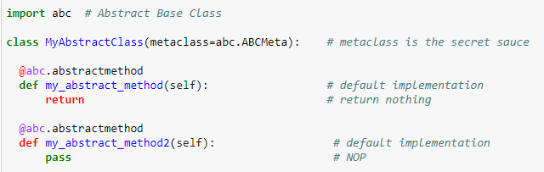
ABC – Abstract Base Class

Slide 8
ABC - Notebook
Let's look at some Abstract Base Class examples in action.
IPY-ABS1-3

Slide 9
Inheritance Review ipy-dcl1
Spacecraft
(base class)
craft_configuration
Derived class
Calling super-class
Voyager
(derived class)
transmit(command)
craft_configuration

Slide 10
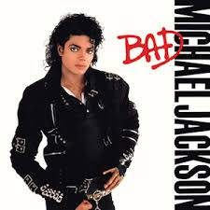
Multiple Inheritance
?

Slide 11
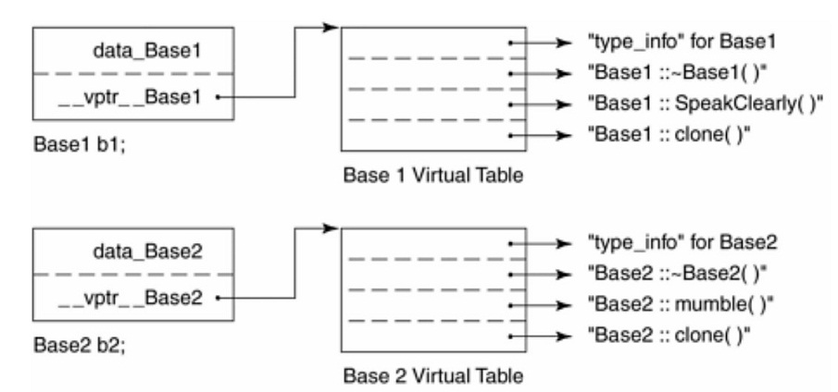
Vtable

Slide 12
Multiple inheritance
Window
(base class)
Python supports...
Sizeable
(derived class)
Editable
(derived class)

Slide 13
Multiple inheritance
Window
(base class)
Diamond of Death
Diamond of Uncertainty
Sizeable
(derived class)
Editable
(derived class)
Editable and Sizeable
(derived class)

Slide 14
HOw do other Common languages deal?
These languages punt on multiple inheritance:
Java
C#
Virtual Base Class
C++
Via Mixins
JavaScript
Elegantly
Python

Slide 15
MI - Notebook
Let's look at multiple inheritance in action.
IPY-MI1

Slide 16
Iterators and Collections
The next few examples leverage our understanding of class definitions and provides a chance to see 'Duck Typing' in action.

Slide 17

Iter() IPY-IT1
The iter() method takes two parameters and returns an iterator for the given object.
object - object whose iterator is to be created (can be sets, tuples, etc.)
sentinel (Optional) - special value that is used to represent the end of a sequence
A user defined collection must implement methods:
__iter__()
__next__()

Slide 18
Container ipy-it2,3
Python’s general purpose built-in containers, dict, list, set, and tuple.
These were covered in depth in the Python Introduction slide deck and notebook.
Defining your own container requires implementing methods:
contains, len, etc.
Subclass an existing container:
list, dict, etc.
Selectively override the methods as necessary

Slide 19
Python packaging

Slide 20
Command line

Slide 21
Native code

